Slide 1

DOCER
单击添加副标题
单击此处添加大标题
Orbital Pursuit
单击此处添加小标题内容单击此处添加小标题内容单击此处添加小标题内容单击此处添加小标题内容
Hackathon Competition
单击添加小标题
https://orbital-pursuit.space/

Slide 2

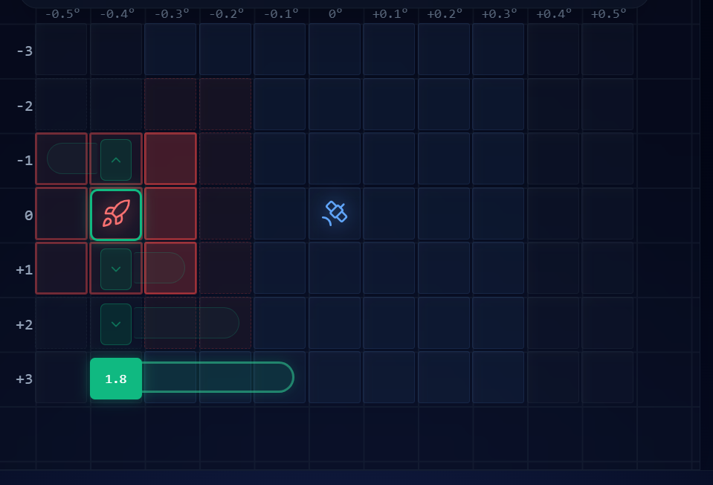

Background
The orbital pursuit-evasion problem:
Orb0 is a geostationary orbit
Orbits higher than Orb0 have a slower relative speed to the Earth
Orbits lower than Orb0 move faster relative to the Earth
The farther away from Orb0, the faster the relative speed
In summary, it will shift left in Orb1, Orb2 and Orb3, remain stationary in Orb0, and shift right in Orb-1, Orb-2 and Orb-3.
https://orbital-pursuit.space/

Slide 3

Background
Pursuer
Evader
Lock onto the target satellite
A 3x3 lock zone
sensing/engagement/capture window
Perform evasive maneuvers
aims to survive under constrained mobility
https://orbital-pursuit.space/

Slide 4
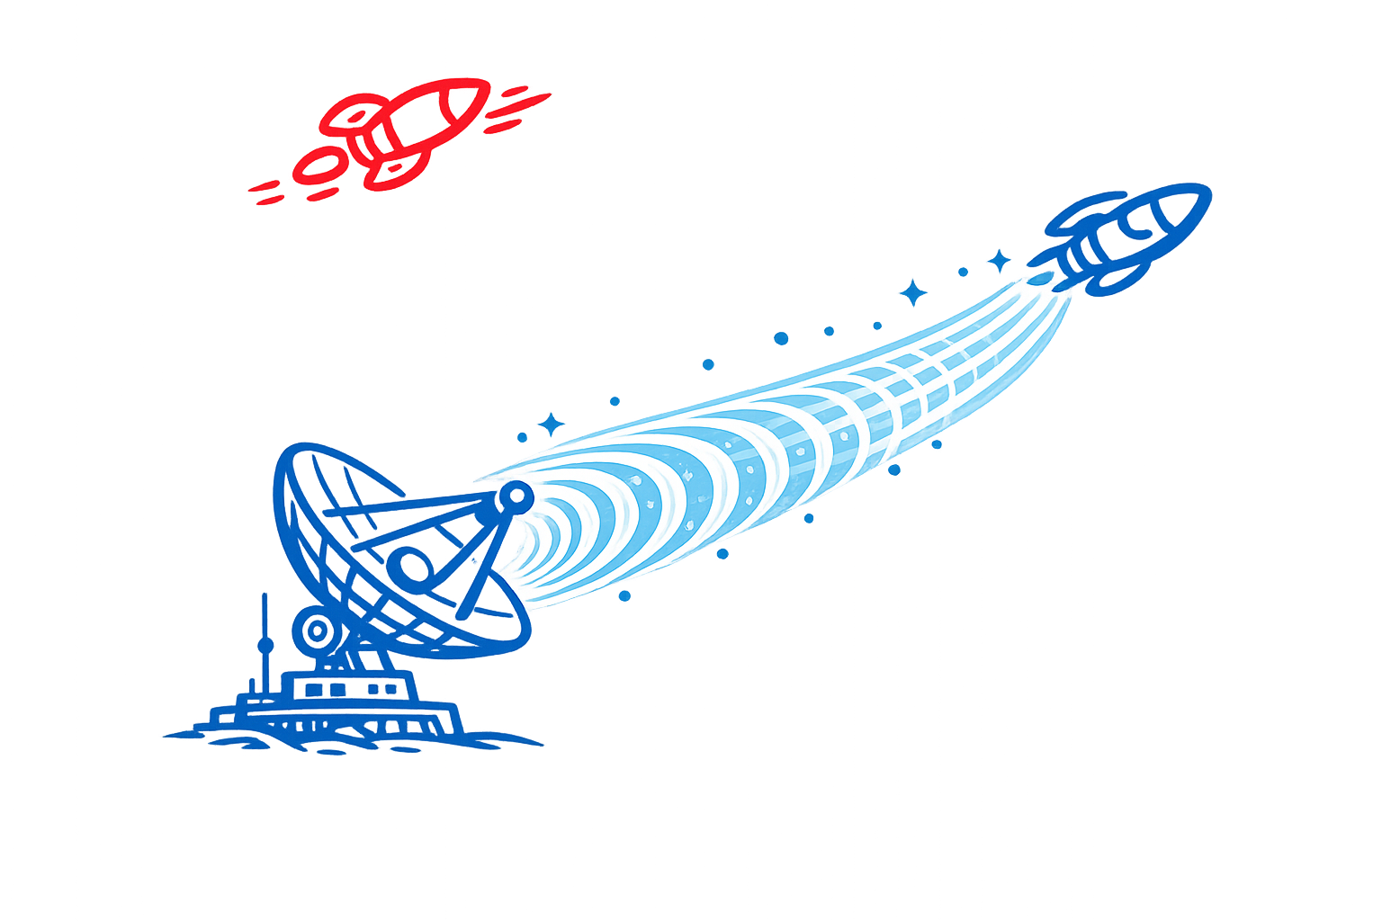
Background
Realistic Mode:
Change the map based on real data
Based on the rules of the real world, our spacecraft can detect the position of the opposing spacecraft every six hours.
The detection mechanism:
Morning: Short-term detection (insufficient duration)
Noon: Detection impossible (light intensity too strong)
Dusk: Short-term detection (insufficient duration)
Night: Short-term detection or long detection
Due to sensor limitations, the satellite can only detect the other spacecraft at a distance of 100 kilometers and capture it at a distance of 50 kilometers.
https://orbital-pursuit.space/

Slide 5
Game Rules
Blind planning: the Evader plans first, then the Pursuer plans, and both moves resolve simultaneously.
The Pursuer (Red) can move across the full map and has a 3x3 lock zone.
If the Evader survives until Turn 20, the Evader wins.
01
02
03
04
05
The Evader (Blue) can only move within the central 5 columns (columns 6-10)
If the Pursuer keeps the Evader inside the lock zone for 2 consecutive turns, the Pursuer wins.
https://orbital-pursuit.space/

Slide 6
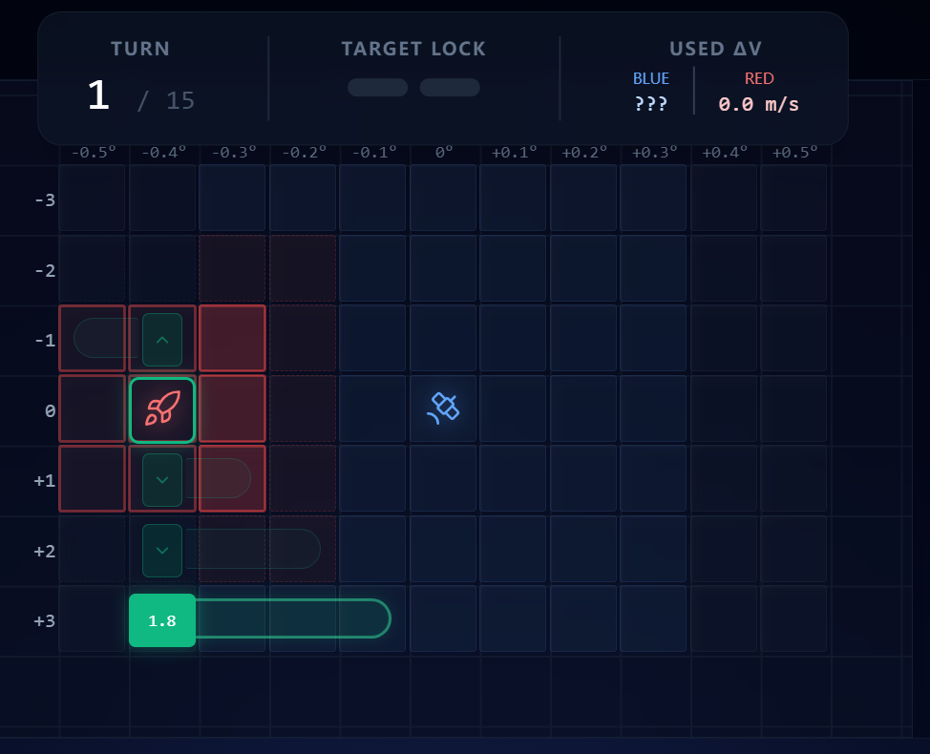
Game Rules
Game Page (Pursuer's Perspective)
Select Orb2 and move it two spaces to the left.
Select Orb1 and move it one space to the left.
Selecting Orb0 does not change left and right.
Select Orb-1 and move it one space to the right.
Select Orb-2 and move it two spaces to the right.
Select the track to determine the next position of the spacecraft.
Game Link
https://orbital-pursuit.space/

Slide 7
DOCER
单击添加副标题
单击此处添加大标题
THANKS
单击此处添加小标题内容单击此处添加小标题内容单击此处添加小标题内容单击此处添加小标题内容
单击添加小标题
https://orbital-pursuit.space/

